Slide 1
This presentation is MR physicists or other personnel responsible for the Marlin QA
Marlin 1.5T QA for Physicists

Slide 3
Presentation Objectives
To give detailed description of the QA procedures of the Marlin 1.5 T system
To learn more about Periodic Image Quality Test, Signal-to-Noise-Ratio Test and Scaling Tests
To perform and analyze 3D Geometric QA
Duration of this presentation is approximately 90 minutes

Slide 4
Quality Assurance Tests
Periodic Image Quality Test (PIQT) is performed to monitor various parameters relevant for system performance.
The System Performance tool (SPT) software is used for acquiring and analyzing phantom images for checking the system performance.
The SNR Test is designed to check the element-wise signal-to-noise ratio of the Marlin Anterior and Posterior coils.
The Scaling Test checks that images are geometrically correctly scaled, both in transverse and coronal planes.

Slide 5
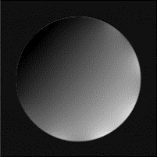

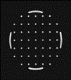
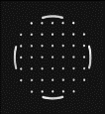
QA Overview
Daily and weekly QA measurements are listed in the table below.
QA procedure | Description | Frequency | Detected failure | Reference
SNR Test | Checks the element-wise signal-to-noise ratio of the Marlin Anterior and Posterior Coils. | Daily Not required when PIQT is performed
Scaling Test TRA Scaling Test COR | Transverse and coronal scan for checking image spatial scaling and geometric accuracy within small FOV. | Daily Not required when PIQT is performed
Periodic Image Quality Test (PIQT) | Evaluates the key properties of MR system performance with three scans. Does not assess the element-wise signal-to-noise ratio nor scaling in the coronal plane. | Weekly

Slide 6
Potential Failure Modes
The test report indicates if the result is Pass or Fail.
Failure mode | May Cause | QA procedures
RF coil fault | Less signal to noise or no images at all | SNR test PIQT
RF receive chain fault | Lower image quality or no images at all | SNR test PIQT
RF transmit chain fault | Lower image quality or no images at all | SNR test PIQT
Reduced spatial accuracy | Image distortion | Scaling test PIQT
Emergency stop / nurse call / anti-virus fail | Safety risks | Daily routine checks
Helium refrigerator fail | Helium boil-off | Magnet check

Slide 7
Considerations on Quality Assurance
Perform the QA tests with the Linac Gantry of the Unity system in a specified angle, for example 0 angulation, during the QA measurements.
Apart from the automatic evaluation, also visually inspect the images.
Failed QA test results do not prohibit scanning.
Caution should be taken when the scanner is used with the QA out of specifications.
Repeated failure indicates that the system is not operating optimally.
In case of repeated failure contact the local Customer Support Organization.
Define your own QA criteria for actions.
User criterion may be stricter than manufacturer criterion to enable an early warning mechanism.

Slide 8

Considerations on Quality Assurance
Position the phantom accurately relative to the isocenter and to the coils.
Repeatability of test results and success in analysis are important.
The tests verify the phantom position and modify the stack position accordingly if the phantom offset is within acceptable limits:
± 6 mm for PIQT, SNR test, scaling test in transverse plane
± 10 mm for scaling test in coronal plane
± 4 mm FH position for 3D Geometric QA.
The acceptable range of parameter values is provided. The test indicates if the result is Pass or Fail.
If parameters are out of specification, repeat the test and check that the phantom and phantom holder are positioned according to the instructions for Use.
If the system is out of specification, the images may be inadequate for treatment planning, which may lead to wrong dose calculation and incorrect treatment delivery.

Slide 9
Periodic Image Quality Test (PIQT)

Slide 10
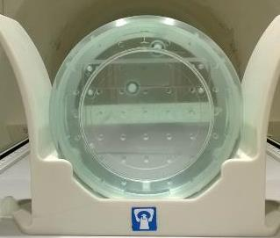
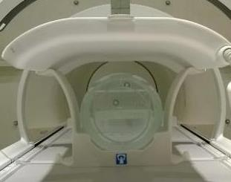
PIQT
Periodic Image Quality Test (PIQT)
The purpose of PIQT is to
check weekly basic system performance in a relatively short time
to monitor basic system performance over time
to have a good starting point to investigate IQ problems.
Automatic image analysis in the background is provided.
Images are saved in the patient database under PIQT.
The Marlin PIQT uses integrated Body coil in addition to Anterior and Posterior coils.
200 mm Head phantom and holder
Setup for PIQT

Slide 11
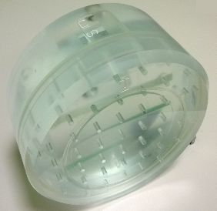

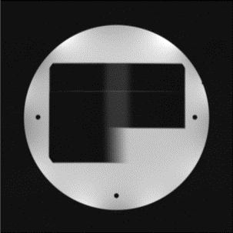
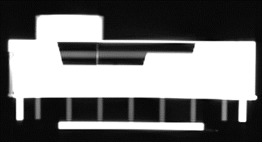

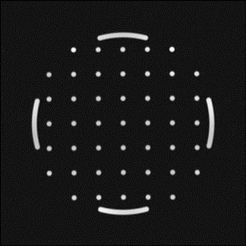

PIQT
Periodic Image Quality Test (PIQT)
The phantom has four sections for measuring various aspects of scanner performance.
PIQT takes an image of each phantom section.
Phantom sections are:
Flood Field Uniformity (FFU) section
SNR
Uniformity
Spatial Linearity (SPL) section
in plane distortion
Slice Profile (SLP) section
slice thickness
Spatial Resolution (SPR) section
pixel size
and outside the phantom
Noise.
200 mm Head phantom
Coronal cross section of the 200 mm head phantom

Slide 12
PIQT Scan Protocols
Imaging parameters of the PIQT scans are listed in the table below.
Scan name | QA1 | QA2 | QA3
Scan mode | MS | MS | 2D
Scan technique | SE | FFE | SE
Receive coil | MRL Anterior MRL Posterior | MRL Anterior MRL Posterior | System Body Coil (QBC)
TE (ms) | 30/100 | 15 | 3*50
TR (ms) | 1000 | 200 | 1000
Acq voxel (mm³) | 1.2 / 1.2 / 5.00 | 1.2 / 1.2 / 5.00 | 0.98 / 0.98 / 15.0
Slices | Noise, SPL, FFU, SLP, SPR | SPL, FFU, SLP | FFU

Slide 13
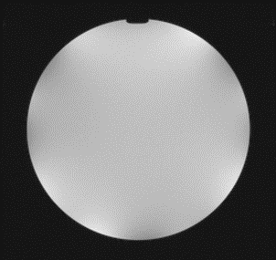
FFU
Flood Field Uniformity
PIQT measurement
FFU image
The Flood Field Uniformity (FFU) section is the area which contains only fluid, resulting in a FFU area of 200 mm of diameter.
FFU section is used to measure Signal to Noise Ratio and image uniformity.
SNR measurement is for regular follow-up.
Stability of the signal chain and the absence of additional sources of noise should be captured with this test.
The signal intensity from a homogenous test phantom is expected to be uniform.
FFU section inside the head phantom

Slide 14
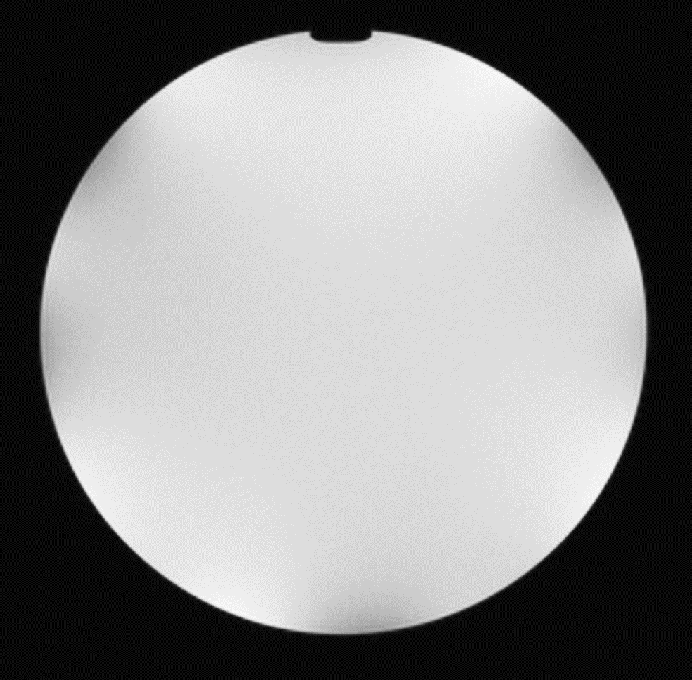
FFU
FFU - Signal to Noise Ratio (SNR)
PIQT measurement
Signal to Noise ratio may be calculated using different methods.
The Philips method (Nema S/N(B) test) uses information in one scan, the standard NEMA* method uses two separate scans for the background noise level.
Positioning and size of ROIs differ from NEMA standard.
NEMA procedure (NEMA MS 1-2008): Alternative SNR (method 4) is used.
QA1, QA2 are measured with MRL Anterior and Posterior coils, QA3 with QBC.
ROI in Center (C)
ROI in background (B)
FFU image – SNR measurement
*NEMA procedure (NEMA MS 1-2008): Alternative SNR (method 4) is used.
NEMA Standards Publication MS 6-2008 (Determination of
Signal-to-Noise Ratio and Image Uniformity for Single-Channel
Non-Volume Coils in Diagnostic MR Imaging Published)

Slide 15
FFU
FFU - Signal to Noise Ratio (SNR)
PIQT measurement
Philips Nema S/N(B) test differs slightly from the standard NEMA test.
The signal ROI (C) for signal estimation is 31 ^{x} 31 px² in the center of the image (= 30 ^{x} 30 mm² with 0.98 ^{x} 0.98 mm² recon pixels).
For noise estimation background ROI (B) is 15 x 62.5 mm² at the corner of the image (3 px away from the edge)
The corner and ROI orientation (horizontal/ vertical) with lowest average signal is chosen.
Noise in magnitude image is not Gaussian but Rayleigh distributed, thus image noise is divided by 0.655.
ROI in Center (C)
ROIs in background (B)
FFU image – SNR measurement

Slide 16
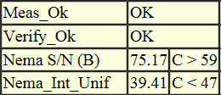
PIQT
Signal to Noise Ratio Results
Analyzing SPT report
Nema S/N (B):
Check that measurements are within specification.
FFU SNR result

Slide 17
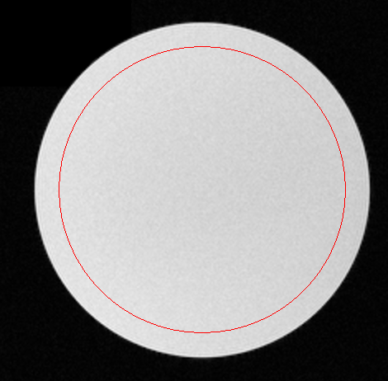
FFU
FFU - Image Uniformity
PIQT measurement
Image uniformity is measured with a region of interest of 170 mm in diameter.
The Philips PIQT approach includes also the ACR and NEMA Integral Uniformity measure, where two small areas of maximal and minimal pixel intensity are chosen and the uniformity index is calculated from how much their average intensities differ:
Image is filtered with a nine-point filter before calculation to reduce noise influences.
ROI in Cnter (C)
FFU image – Uniformity

Slide 18
PIQT
Image Uniformity Results
Analyzing SPT report
The smaller the number, the better.
Check that measurements are within specification.
Often used percent integral uniformity (PIU) is
1-Nema/100.
FFU image Uniformity result

Slide 19
FFU – Possible Causes of Failure
If the coils are placed incorrectly, closer to or further from the phantom as intended, the test may fail.
Position the phantom as instructed in Marlin 1.5T Instructions for Use.
An indicator of the problem is the appearance of non-symmetrical intensity distribution in the phantom.
Failure of components in the coils, and from failure of the mechanisms for inductive decoupling of the body coil from the surface coils can result in degraded image intensity uniformity or SNR.
In these cases the images usually become noticeably lower in signal-to-noise ratio, usually appearing more grainy.
RF interference from RF emitters in the treatment room, such as screens, fluorescent lights, or the Linac system can result in lower SNR.
Image ghosting can cause image intensity variations and hence failure of this test.
Ghosting is a very nonspecific symptom of a hardware problem.
Ghosting sufficient to cause failure is readily apparent in the image.
In general, it is caused by instability of the measured signal, which can have its origin in the receiver, transmitter, or gradient subsystems.

Slide 20
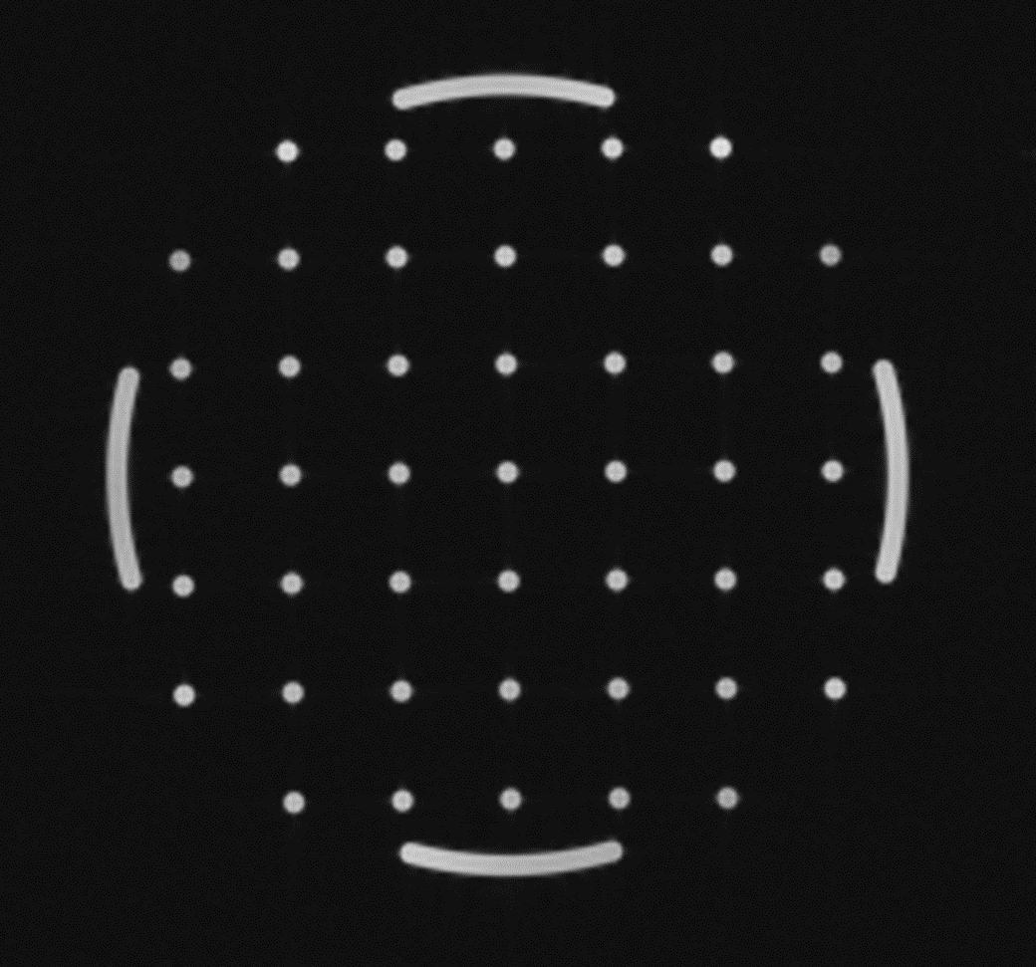
SPL
Spatial Linearity
PIQT measurement
SPL image
The SPL section contains 45 holes of 5 mm diameter separated by 25 mm in horizontal and vertical directions in a rectangular grid of 150 mm x 150 mm for assessing correct scaling of images.
The maximum observed deviation of the phantom diameter is to be followed.
SPL section inside the head phantom

Slide 21
SPL
SPL - Differential Linearity
PIQT measurement
Differential linearity calculates the relative deviation of the distance between 2 dots.
Differential linearity assess phantom dimensions radially in 8 directions.
The Philips PIQT test inherently includes also the method recommended by ACR and NEMA.
SPL image, where distance between orthogonal holes is measured

Slide 22
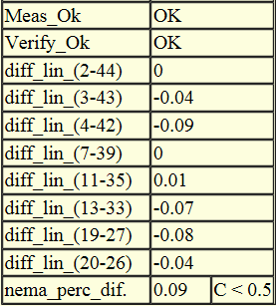
PIQT
Spatial Linearity Results
Analyzing SPT report
Nema_perc_dif is the number that is expected to follow.
Check that measurements are within specification.
Result is expressed in %.
SPL result

Slide 23
SPL – Possible Causes of Failure
Miscalibrated gradients
The gradient amplifiers need time to warm up and stabilize after they are turned on.
Abnormally high B0 inhomogeneity could cause significant dimensional errors in the phantom images.
Such B0 inhomogeneity could be caused by improper adjustments, a ferromagnetic object such as a large hair clip lodged in the magnet bore, or modifications in the Linac hardware.
Notes:
Standard set of measures that are also used routinely in diagnostic imaging.
Include NEMA standard measures of the following technical IQ parameters
•Signal to noise ratio (FFU section of the phantom)
•Flood field uniformity
•Spatial linearity (distortion) (in-plane distortion)
•Slice profile / Slice thickness
•Spatial resolution (details)
- NEMA Standards Publication MS 6-2008 (Determination of Signal-to-Noise Ratio and Image Uniformity for Single-Channel Non-Volume Coils in Diagnostic MR Imaging Published)
- NEMA Standards Publication MS 5-2010: Determination of Slice Thickness in Diagnostic Magnetic Resonance Imaging
Published

Slide 24
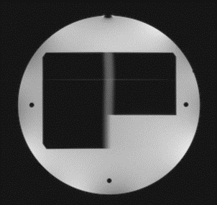
SLP
Slice Profile
PIQT measurement
SLP image
The SPL section of the head phantom contains wedge shaped structures called ramps and wedge for assessing the slice profile.
Performance of the RF chain is expected to remain unchanged.
Slice profiles and locations are unchanged too.
SLP section inside the head phantom

Slide 25
PIQT
Slice Profile Measurement
Analyzing SPT report
Slice profile can be assessed from a thin ramp, which is inside the phantom.
Wedge
Measurement from wedge, when slice thickness < 5 mm
Image
Ramp
1 mm
Measurement from wedge, when slice thickness ≥ 5 mm
Image
Nema_FWHM: Full Width at Half Maximum (mm)
Slice profile
Intensity
Nema_Slice_int.: Slice integral (mm)
Nema_FWTM: Full Width at Tenth Maximum (mm)
Intensity
Position
NEMA Standards Publication MS 5-2010: Determination of Slice Thickness in Diagnostic Magnetic Resonance Imaging Published
Measurement of a slice profile

Slide 26
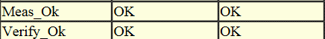
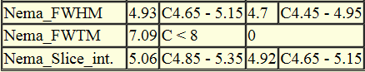
PIQT
Slice Profile Results
Analyzing SPT report
Nema_FWHM, and Nema_Slice_int are the numbers to be followed.
The shape and location of a 2D slab of excited spins in MRI system, that is, slice profile and location, are largely dependent on the RF pulse shape. The magnetic field gradients also play a role.
Check that measurements are within specification.
Nema_FWHM: Full Width at Half Maximum (mm) Nema_FWTM: Full Width at Tenth Maximum (mm) Nema_Slice_int.: Slice integral (mm)
SLP result

Slide 27
SLP – Possible Causes of Failure
Nonlinearity of the radiofrequency (RF) amplifier can cause distorted RF pulse shapes and failure of this test.
Distorted RF pulse shapes can arise from malfunctions anywhere in the high power RF portion of the transmitter, in other words, in the RF power amplifier, in the cables and RF switches that convey power from the amplifier to the transmitter coil, or in the transmitter coil itself.
Extremely bad gradient calibration or poor gradient switching performance can also cause a failure of this test.

Slide 28

SPR
Spatial Resolution
PIQT measurement
SPR image
The SPR section contains slightly tilted edges for determining spatial resolution.
The spatial resolution measures the smallest detail that is visible in the test images, that is the impact of blur.
SPR measurement is for regular follow-up.
SPR section inside the head phantom

Slide 29
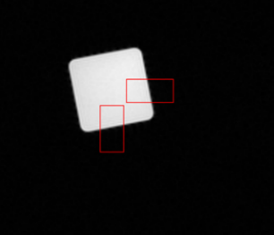
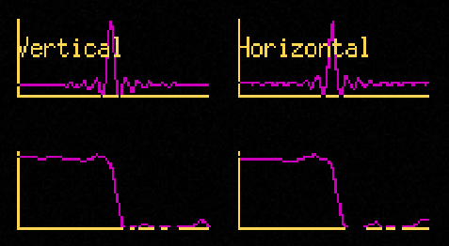
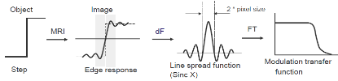
SPR
Philips Spatial Resolution Measurement
PIQT measurement
Philips method measures spatial resolution as the width between the two first zero crossings of the Line Spread Function, which is measured from the profile of an edge in the phantom.
Practical Philips solution for measuring system resolution performance:
Record a profile of an ideal object edge
Derivate it to get line spread function and
Fourier transform it to get the modulation transfer function.
Width of line spread function gives twice the pixel size and MTF value at Half Maximum gives the maximum number of line pairs per pixel. For an ideal system this value is 0.5 corresponding to one line per pixel.
SPR measurements

Slide 30
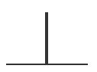
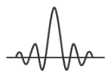

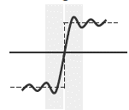
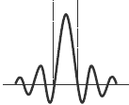
PIQT
Spatial Resolution
Analyzing SPT report
Spatial resolution is determined from edge response function.
In theory it should be able to resolve 2 points when they are further away from each other than half of the width of the peak.
Practically that is not possible. Object with an edge (step) is imaged, and as a result same type of signal is received.
Spatial resolution may differ in frequency and phase encoding direction.
Unit is recon pixels, for PIQT it corresponds to mm.
Theory
MRI
Needle
Practical solution
Image
2*pixel size
Step
MRI
dF
Object
Edge response
Line spread function
Measurement of spatial resolution

Slide 31
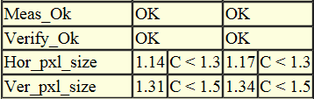
PIQT
Spatial Resolution Results
Analyzing SPT report
Hor_pxl_size and Ver_pxl_size are the numbers to be followed.
These values correspond to the smallest detail visible in the image.
Result may differ in frequency and phase encoding direction.
Unit is in reconstruction pixels
For PIQT corresponds to 1 mm.
Check that measurements are within specification.
SPR result

Slide 32
SPR – Possible Causes of Failure
If the coils are placed incorrectly, closer to or further from the phantom as intended, the test may fail.
Position the phantom as instructed in Marlin 1.5T Instructions for Use.
An indicator of the problem is the appearance of non-symmetrical intensity distribution in the phantom.
Poor eddy current compensation can cause a failure.
Excessive image ghosting can cause image intensity variations and hence a failure of this test.
Ghosting is a very nonspecific symptom of a hardware problem.
In general, ghosting is caused by instability of the measured signal, which can have its origin in the receiver, transmitter, or gradient subsystems. Motion of the phantom can also cause ghosting.
Make sure the phantom is stable in the coil and not free to move or vibrate.
Notes:
Standard set of measures that are also used routinely in diagnostic imaging.
Include NEMA standard measures of the following technical IQ parameters
•Signal to noise ratio (FFU section of the phantom)
•Flood field uniformity
•Spatial linearity (distortion) (in-plane distortion)
•Slice profile / Slice thickness
•Spatial resolution (details)
- NEMA Standards Publication MS 6-2008 (Determination of Signal-to-Noise Ratio and Image Uniformity for Single-Channel Non-Volume Coils in Diagnostic MR Imaging Published)
- NEMA Standards Publication MS 5-2010: Determination of Slice Thickness in Diagnostic Magnetic Resonance Imaging
Published

Slide 33
Summary of Relevant PIQT Report Parameters
See NEMA* guidelines for description of the NEMA calculations.
Section | Parameter name | Description
Flood Field Uniformity (FFU) | Nema S/N (B) | Signal to noise ratio
 | Nema_Int_Unif | Integral uniformity
Spatial Linearity (SPL) | diff_lin(x-y) | Differential linearity between points x and y (percent difference measured vs. actual distance)
 | nema_perc_dif. | Max absolute difference in percent measured vs. actual distance
Slice Profile (SLP) | Nema_FWHM | Full width at half maximum of slice profile
 | Nema_FWTM | Full width at tenth maximum of slice profile
 | Nema_Slice_int. | Integral of slice profile
Spatial Resolution (SPR) | Hor/ver_pxl_size | Width between the two first zeros of the line spread function
* NEMA: The Association of Electrical Equipment and Medical Imaging Manufacturers
Magnetic Resonance Standards (http://www.nema.org/Standards/Pages/All-Standards-by-Product.aspx?ProductId=604e6a9c-e279-4133-8d16-12ba6b64fb24)

Slide 34
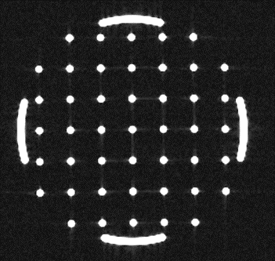
Review Images
Select Patients > Review Images, select PIQT and the correct date for review.
PIQT results can be analyzed by:
Image review
Print out or view results as report and trend.
Visual assessment of artifact and ghost level by reviewing the PIQT images.
Artifact and ghost level can be checked by windowing the images.
Visual check is only to qualitatively compare current result to the previous acceptable result.
Example of PIQT image windowed to show possible ghosting
- in this image no ghosting was visible

Slide 35
Coil SNR

Slide 36
SNR test
Coil SNR Test
The purpose of the SNR test is to assess quickly the overall performance of the system, especially the function of the RF receive coils.
Test is used daily to verify that
the MR system can obtain images with sufficient image quality
all elements of the coils are working.
The test uses the same phantom setup as PIQT.
200 mm Head phantom and phantom holder.
Test is performed in transverse plane.
The test calculates
the signal-to-noise ratio (SNR) for each coil element
the SNR for the whole image.
Setup for PIQT
Scan name | MRL_ACPC_T
Scan mode | 2D
Scan technique | FFE
Receive coil | MRL Ant/Post
TE (ms) | 4.2
TR (ms) | 30
Acq voxel (mm³) | 1.3 / 1.3 / 10.0
Slices | FFU
Imaging parameters of the SNR test

Slide 37
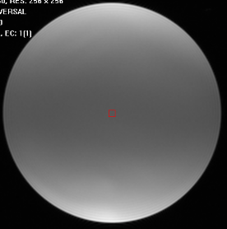
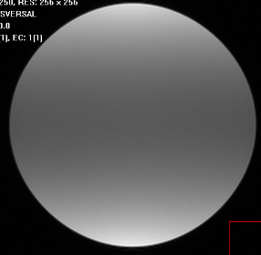
SNR test
Coil SNR Test
Full image SNR is measured.
Every coil element of Posterior coil and Anterior coil are measured separately.
Roi in Centre (C) 7x7 px²
Roi in background (B) 36x36 px²
Full image SNR

Slide 38
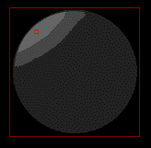
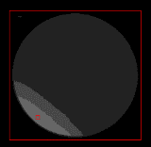
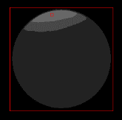
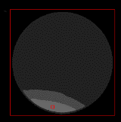
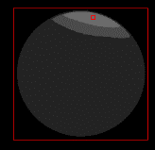
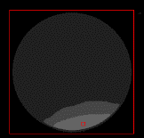
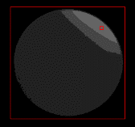
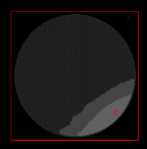
SNR test
Coil SNR Test
Anterior coil
Posterior coil
Element-by-element reconstructed and binned (adjacent pixels are combined) images from the four channels of the Marlin Anterior and Posterior coils with the corresponding signal ROIs.
MRL_ACPC_T_1
MRL_ACPC_T_5
MRL_ACPC_T_2
MRL_ACPC_T_6
MRL_ACPC_T_3
MRL_ACPC_T_7
*NEMA Standards Publication MS 6-2008 (Determination of
Signal-to-Noise Ratio and Image Uniformity for Single-Channel
Non-Volume Coils in Diagnostic MR Imaging Published)
MRL_ACPC_T_4
MRL_ACPC_T_8
Elementwise SNR

Slide 39
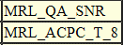
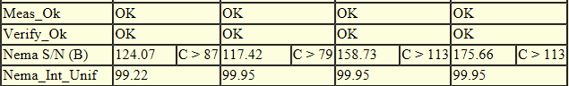
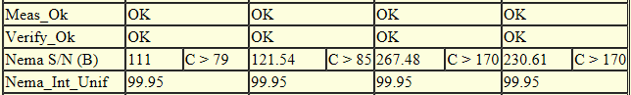
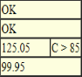
SNR test
Coil SNR Test result
Signal-to-Noise ratio for each element of the coil is presented.
Result of the SNR for the whole image
Elementwise SNR results
Anterior coil elements 1-4 , Posterior coil elements 5-8
Results of the SNR test

Slide 40
Coil SNR Test – Possible Causes of Failure
If the coils are placed incorrectly, closer to or further from the phantom as intended, the test may fail.
Position the phantom as instructed in Marlin 1.5T Instructions for Use.
An indicator of the problem is the appearance of non-symmetrical intensity distribution in the phantom.
If coil elements are broken, the test may fail.
It is important to position the coils always so that their green zone is in the radiation window. Sensitive electronics may break if they are placed in the radiation beam path.
Failure of components in the coils, and from failure of the mechanisms for inductive decoupling of the body coil from the surface coils can result in degraded image intensity uniformity or SNR .
In these cases the images usually become noticeably lower in signal-to-noise ratio, in other words, they usually appear more grainy.
RF interference from Linac system and patient positioning system can result in lower SNR.
Notes:
Standard set of measures that are also used routinely in diagnostic imaging.
Include NEMA standard measures of the following technical IQ parameters
•Signal to noise ratio (FFU section of the phantom)
•Flood field uniformity
•Spatial linearity (distortion) (in-plane distortion)
•Slice profile / Slice thickness
•Spatial resolution (details)
- NEMA Standards Publication MS 6-2008 (Determination of Signal-to-Noise Ratio and Image Uniformity for Single-Channel Non-Volume Coils in Diagnostic MR Imaging Published)
- NEMA Standards Publication MS 5-2010: Determination of Slice Thickness in Diagnostic Magnetic Resonance Imaging
Published

Slide 41
Scaling Test

Slide 42
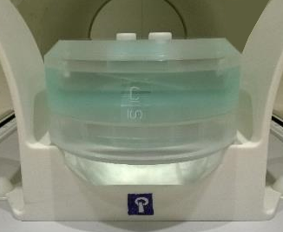
Scaling test
Scaling Test
Scaling test evaluates image scaling in transversal and coronal planes.
The purpose of this test is to verify daily that scaling of images are within specifications inside the phantom dimensions.
Changes outside of this field of view are unknown.
Test involves two parts,
transversal plane scaling
Transversal scaling is also included in the PIQT test.
coronal plane scaling.
The two tests are otherwise the same, except for the phantom and image orientation that are varied between the parts to cover all three dimensions.
Head phantom setup for Scaling test in coronal plane
Scan name | SCALING_TRA | SCALING_COR
Scan mode | MS | MS
Scan technique | SE | SE
Orientation | Transverse | Coronal
Receive coil | MRL Ant/Post | MRL Ant/Post
TE (ms) | 30 | 30
TR (ms) | 400 | 400
Acq voxel (mm³) | 0.98 / 0.98 / 10.0 | 0.98 / 0.98 / 5.0
Slices | SPL | SPL
Imaging parameters of the Scaling test

Slide 43
Spatial Linearity
Spatial linearity is analyzed the same way as in PIQT.
Differential linearity calculates the relative deviation of the distance between 2 dots.
Differential linearity assess phantom dimensions radially in 8 directions.
The Philips PIQT test inherently includes also the method recommended by ACR and NEMA.
Spatial linearity measurement

Slide 44
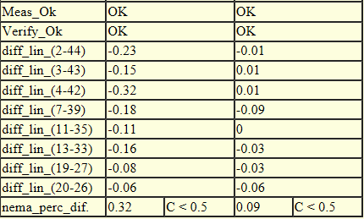
Scaling Test result
Analyzing Scaling tests
Nema_perc_dif is the number to be followed.
Additionally, the individual diff_lin_(xx) parameters can be looked at.
Check that measurements are within specification.
SNR test result

Slide 45
Scaling Test– Possible Causes of Failure
Miscalibrated gradients
The gradient amplifiers need time to warm up and stabilize after they are turned on.
Abnormally high B0 inhomogeneity could cause significant dimensional errors in the phantom images.
Such B0 inhomogeneity could be caused by improper adjustments, a ferromagnetic object such as a large hair clip lodged in the magnet bore, or modifications in the Linac hardware.
Notes:
Standard set of measures that are also used routinely in diagnostic imaging.
Include NEMA standard measures of the following technical IQ parameters
•Signal to noise ratio (FFU section of the phantom)
•Flood field uniformity
•Spatial linearity (distortion) (in-plane distortion)
•Slice profile / Slice thickness
•Spatial resolution (details)
- NEMA Standards Publication MS 6-2008 (Determination of Signal-to-Noise Ratio and Image Uniformity for Single-Channel Non-Volume Coils in Diagnostic MR Imaging Published)
- NEMA Standards Publication MS 5-2010: Determination of Slice Thickness in Diagnostic Magnetic Resonance Imaging
Published

Slide 46
Evaluation of the Results

Slide 47
General Guideline for Result Interpretation
Measurement results are not always correct due to, for example artifacts.
Always review the images created.
The correct positioning of the phantom is important.
Air bubbles & moving phantom fluid will influence the results.
Compare the results with previous scans to detect if there is a deterioration of the system.
Notes:
Standard set of measures that are also used routinely in diagnostic imaging.
Include NEMA standard measures of the following technical IQ parameters
•Signal to noise ratio (FFU section of the phantom)
•Flood field uniformity
•Spatial linearity (distortion) (in-plane distortion)
•Slice profile / Slice thickness
•Spatial resolution (details)
- NEMA Standards Publication MS 6-2008 (Determination of Signal-to-Noise Ratio and Image Uniformity for Single-Channel Non-Volume Coils in Diagnostic MR Imaging Published)
- NEMA Standards Publication MS 5-2010: Determination of Slice Thickness in Diagnostic Magnetic Resonance Imaging
Published

Slide 48
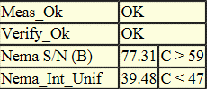
MRL Specifications Files
QA Specifications are provided that are used to indicate pass or fail of particular QA tests.
Range values indicate if each measured parameter is within its expected range.
Service engineers may update range values during a service visit.
Current specifications are based on measurements performed at the Philips factory on test systems.
Example of a test result

Slide 49
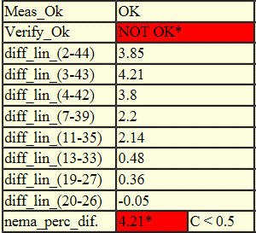
MRL Specifications Files: Case of Failure
QA Specifications are provided that are used to indicate pass or fail of particular QA tests.
In case of measurement does not reach the specified acceptance value, NOT OK* is written to the Verify_Ok.
Example of a failed test result

Slide 50
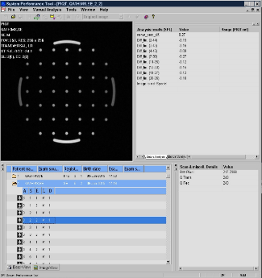
Evaluate the Results
Test result can be viewed in the Image View of the System performance Tool.
Select Image View > current study name
> PIQT and open the folder to review PIQT results
> MRL_QA_SNR and open the folder to review SNR test results
> MRL_QA_SCALING and open the folder to review scaling test in transverse and coronal planes.
Select a scan, double-click the slice to display the image.
The analysis results are shown on the right side of the image.
Select Patient > Open for Review to view the images.
Example of the result of the PIQT

Slide 51
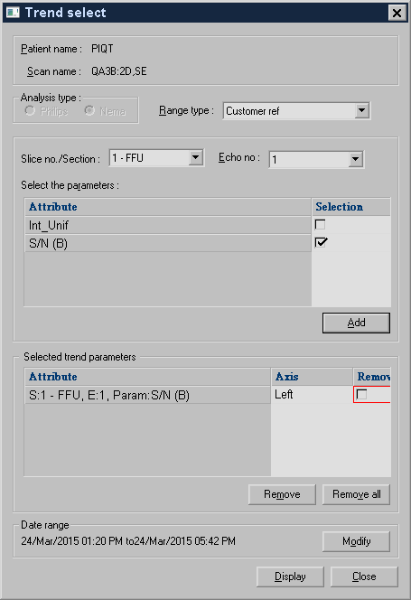
View Trend
Trending tool can be used for monitor system performance over time and potentially detect forthcoming image quality issues.
Trending tool can be viewed in the Image View of the System performance Tool.
Select the correct study from the examination list, right-click the folder > View Trend.
Select the parameters to be displayed.
Up to 5 parameters can be selected.
Trend select window

Slide 52
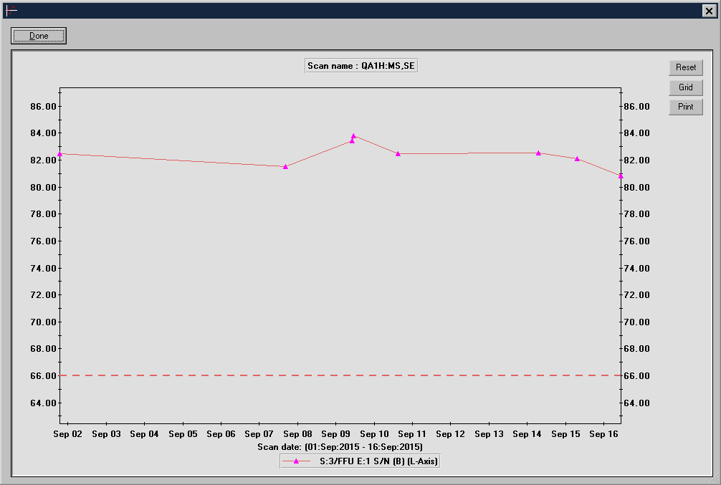
Example of View Trend

Slide 53
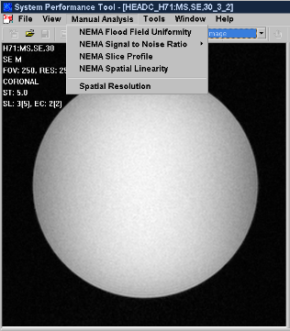
Manual Analysis for Own Scans
SPT tools can also be used to analyze your own sequences.
Image the 200 mm Head phantom with your own scan.
In SPT tool, select the image set > Image View.
The analysis can be performed by selecting Manual Analysis, then select the analysis to be run.
Results are shown next to the image, on the right panel.
Example of selection of Manual analysis

Slide 54
3D Geometric QA Analysis

Slide 55
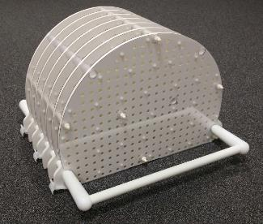

3D Geometric QA
3D Geometric QA Phantom
The 3D Geometric QA Analysis procedure is intended for evaluating the geometric accuracy of MR images taken with the Marlin 1.5T scanner.
The 3D geometric QA image acquisition takes approximately 10 minutes.
3D Geometric QA components are:
3D Geometric QA Phantom
System Body Coil (QBC) for imaging
Analysis software.
3D Geometric phantom is not intended to be irradiated, store the 3D Geometric phantom outside the treatment room.
3D Geometric phantom
Setup for 3D geometric QA

Slide 56

3D Geometric QA
3D Geometric QA Phantom
The 3D Geometric QA phantom
Consists of seven flat plates
Covers a cut cylindrical volume of diameter 50 cm and of length 33 cm
There is 1932 markers in well-defined locations
Marker spacing is 25 x 25 x 55 mm³
Total weight of the phantom is 28.5 kg
Includes clamps for indexing and rigid fixing to the tabletop of the patient support.
Bring the 3D geometric phantom to the treatment room one hour before the measurements, if there is a over 2°C (3.6°F) temperature difference between the storage room and the treatment room.
The phantom temperature stabilizes and misleading results due to thermal expansion of the phantom can be avoided.
3D Geometric phantom
Phantom image with markers

Slide 57


3D Geometric QA
Acquire Geometric QA Images
Open Batch File
Run automatic SPT tool 3D_Geometric_QA.
Online instructions are included for the 3D Geometric QA to assist in performing the 3D Geometric QA Analysis.
Select System > SPT
Double-click Batch Files > Geometric_QA > 3D_Geometric_QA.
Right-click 3D_Geometric_QA > Run Batch to start the test.
Follow the online instructions.
SPT tool Run Batch

Slide 58




3D Geometric QA
Position the Geometric QA Phantom
Open Batch File
Set-up the 3D Geometric QA
Remove the mattress from the tabletop.
Position the 3D Geometric QA phantom onto the tabletop at index 22.
Position the symbol Towards the Bore facing the magnet.
Carry 3D Geometric QA Phantom with two persons using the phantom handles.
Move the phantom to the magnet isocenter.
3D Geometric QA phantom should be positioned on the tabletop with the accuracy of 4 mm in head-feet direction.
If the system detects larger offset, repositioning of the phantom is required.
Two persons carrying 3D geometric phantom
Setup for 3D geometric QA

Slide 59


3D Geometric QA
Acquire the Geometric QA Images
Open Batch File
Set-up the 3D Geometric QA
Scan images
Click Proceed to start the acquisition.
No user actions are required.
If there is a failure situation detected, an error message is displayed.
After the scanning is completed message Batch execution finished successfully
is shown. Click OK.
Example of an error message, when the 3D Geometric QA phantom is positioned incorrectly
Message of Batch execution finished successfully

Slide 60

3D Geometric QA
Analysis of 3D Geometric QA
Open Batch File
Set-up the 3D Geometric QA
Scan images
After the scans are finished, the Geometric QA Analysis tool automatically analyzes the results.
The analysis shows the measured distortion (mm) in predefined volumes around the isocenter.
The distortion for each marker is defined as the difference between the detected and physical marker position.
The analysis automatically takes into account small mispositioning and misalignment of the phantom.
The measured distortion is determined as the maximum distortion of the markers in each volume, after discarding 2% of the markers with largest distortion. The discard proportion (2%) includes the markers that were not reliably detected.
The discarding is done to avoid bias in the results due to, for example, partially visible markers at the edges of the image FOV.
Analyze 3D Geometric QA
Geometric QA Analysis result

Slide 61
3D Geometric QA
Export Results
Open Batch File
Set-up the Geometric QA
Scan images
The results can be exported in the Geometric QA Analysis of the System performance Tool and
Geometric QA Analysis open,
Click Export > select a folder > OK to save the results.
Analyze 3D Geometric QA
Export and view results
Geometric QA Analysis window

Slide 62
3D Geometric QA
Export Results
Export and view results
Results as txt and bmp files are exported.
Summary of the results
Marker locations
Distortion maps
Debug images, one images for each phantom plate
Exported files are listed in the table below.
Filename | Description
geometric_qa_analysis_summary_<timestamp>.txt | A summary of the analysis results. Includes the number of detected markers in each DSV.
geometric_qa_analysis_marker_locations_<timestamp>.txt | A list of reference and observed coordinates for each marker in the phantom, their weighted standard deviation, their effective radius, and their status.
geometric_qa_analysis_distortion_maps_<timestamp>.bmp | A color map of the measured distortions for each phantom plate, where each pixel in the map corresponds to a single marker.
geometric_qa_analysis_debug_image_H<coord>_<timestamp>.bmp | A debug images showing the detected and physical marker locations on top of the analyzed MR image. A separate image file is saved for each phantom plate. Export saves several of these images to the disk.
File names and description of the exported files

Slide 63

3D Geometric QA
Export Results: Summary
Export and view results
File of geometric_qa_analysis_summary_<timestamp>.txt
Summary gives measured distortions in different directions for different DVSs.
Column | Description
DSV | Diameter (mm) of a spherical volume around the MR coordinate system origin
Total ( max) | Total maximum measured distortion (mm) calculated as the lenght of he distortion vector
RL / AP / FH (max) | Maximum measured distortion (mm) in RL/AP/FH direction
Total/RL/AP/FH (98% perc.) | Maximum measured distortion (mm) after discarding 2% of markers with the largest total/RL/AP/FH distortion
n/N | Number of markers detected / number osf all markers inside the analyzed volume
N/A | Proportion of markers not detected by the analysis is larger than the proportion of markers discarded
File names and description of the exported files

Slide 64

3D Geometric QA
Export Results: Marker Locations
Export and view results
File of geometric_qa_analysis_marker_locations_<timestamp>.txt
A list of reference and observed coordinates for each marker in the phantom, their weighted standard deviation, their effective radius, and their status.
Example of file names and description of the exported files

Slide 65

3D Geometric QA
Export Results: Marker Locations
Export and view results
File of geometric_qa_analysis_marker_locations_<timestamp>.txt
File names
Column | Description
Ref_RL, ref_AP, ref_FH | Reference marker’s physical location corrected for the phantom offset and rotation during the measurement
obs_RL, obs_AP, obs_FH | Observed marker’s measured position
std_RL, std_AP, std_FH | Standard deviation of pixel locations with respect to mass centrum in observed marker
r_eff | Effective radius is the radius of the sphere that has the same volume as there are voxels in the observed marker.
status | Fiducial status (see next slide)
Status ID, label and description of status ID

Slide 66
3D Geometric QA
Export Results: Status
of Marker Locations
Export and view results
File of geometric_qa_analysis_marker_locations_<timestamp>.txt
Description of the marker statuses shown in the marker locations file and in the debug images.
Result of marker locations
ID | Label | Description
0 | Unknown | Used only in case of a SW error
1 | Valid | Marker is detected reliably
2 | Out of FOV | The search ROI is out of the image FOV
3 | Only zero voxels | The searching ROI contains only zero voxels. Typically, this means that the ROI is in the region of the image that has been masked out.
4 | Marker too small | The effective marker radius, estimated from the number of voxels above the noise threshold, is too small. The detected marker location may be inaccurate.
5 | Marker too large | The effective marker radius, estimated from the number of voxels above the noise threshold, is too large. The detected marker location may be inaccurate.
6 | Standard deviation too large | The weighted standard deviation of the marker center of mass is too large. Typically, this means that the marker is either too spread out or that the search ROI contains two markers. Hence, the detected marker location may be inaccurate.
7 | Not fully inside ROI | The calculated center of mass is too far away from the center of the search ROI. Typically this means that the marker did not fit fully in the ROI and thus the detected marker location may be inaccurate.
Status ID, label and description of status ID

Slide 67


3D Geometric QA
Export Results: Debug Images
Export and view results
File of geometric_qa_analysis_distortion_maps_<timestamp>.bmp
Distortion map can be used for illustrating an overview of geometric accuracy of the Marlin system.
The circles describe a 400 mm DSV

Slide 68


3D Geometric QA
Export Results: Distortion Maps
Export and view results
File of geometric_qa_analysis_debug_image_H<coord>_<timestamp>.bmp
Debug images show all markers with a color coded status.
Reference position
Observed position
Marker too small
Marker too large
Standard deviation too large
Not fully inside ROI
Phantom image with markers

Slide 69

3D Geometric QA
View Trend
Open Batch File
Set-up the Geometric QA
Scan images
View trends to identify possible changes in the system performance.
The System Performance Tool and Geometric QA Analysis open, click View Trend.
Trend to be reviewed can be optimized by time, distortion in mm or by DSV visibility.
Analyze 3D Geometric QA
View Trend
Select the Start date and End date
Select maximum and minimum distortion in mm
Select visibility of the curves of Spherical volume (DSV)
Example of a trending

Slide 70
Considerations of the 3D Geometric QA
The reported distortion results are specific to the T1-weighted 3D FFE scan in this QA.
Images acquired with other scan protocols may have smaller or larger distortion, depending on, for example, the read-out bandwidth and eddy current effects.
Due to the gap in the marlin gradient coil, it is common to have relatively large distortion at the edges of the isocenter plane.
In certain situations, the 3D Geometric QA analysis may abort the analysis or no results are reported for some DSVs (N/A shown on the UI and result files).
Save the results to further investigate the source of the error.
In case the problem persists, contact your local service organization.

Slide 71
3D Geometric QA - Possible Causes of Failure
Analysis aborted – not enough markers detected from images
The analysis did not detect enough markers to be able to continue the analysis.
Check that
The markers are visible in the 3D Geometric QA scan images
The phantom is correctly positioned in all planes, and not rotated on the table.
Analysis aborted – phantom rotation too large
The analysis estimated that the phantom rotation is too large to obtain accurate results.
Make sure, that the phantom is correctly positioned and not rotated on the table.
Analysis failed in some DSVs – N/A shown in results
The analysis detected less than 98% of the markers in some of the spherical volumes, and no result was reported for this DSV.
A message notifying about unexpectedly large distortions
The analysis detected large distortion in image data.
One reason might be, that gradient linearity might be affected.
Check that
the 3D geometric phantom is not damaged
B0 homogeneity is not affected by something, such as new equipment in the treatment room.

Slide 72
Summary
Perform the QA tests with the Linac Gantry of the Unity system in a specified angle during the QA measurements.
Position the phantom accurately relative to the isocenter and to the coils.
The acceptable range of parameter values is provided. The test indicates if the result is Pass or Fail.
If parameters are out of specification, repeat the test and check the following:
the phantom and phantom holder are positioned according to the Instructions for Use
the table and MR-to-MV calibrations have been performed.
The 3D Geometric QA procedure is intended for evaluating the geometric accuracy of MR images
3D Geometric phantom and 200 mm Head phantom are not intended to be irradiated.

